Slide 1
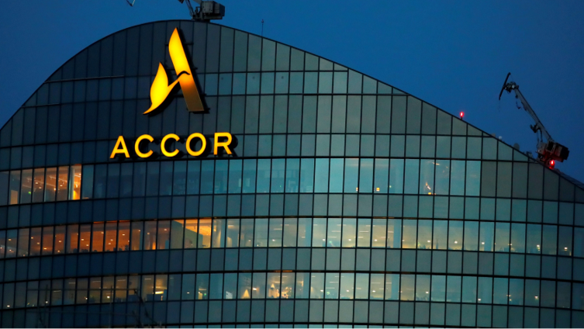


Strengthening the Brand with Digital Marketing
MBA631A: Group 2 Presentation

Slide 2

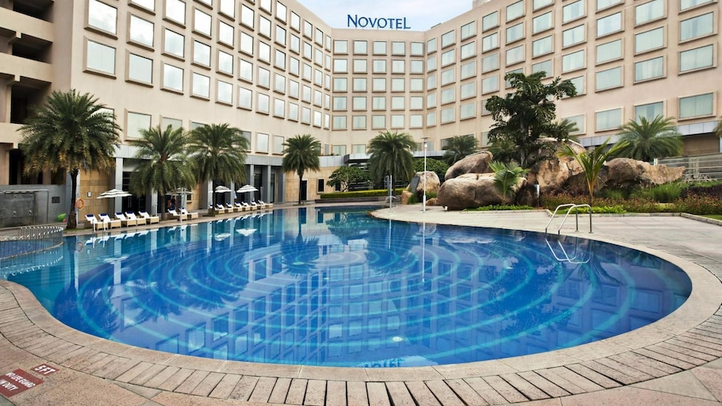

Overview
Accor – A leading hotel operator, with the motto, “To open new frontiers in hospitality.”.
New Chairman and CEO, Sebastian Bazin. – “In this industry, those who master digital will win. We see digital not as a threat but as a massive opportunity.’.
Needed to further explore the digital frontier via a new online distribution channel.
Digital could become a competitive advantage in increasing customer acquisition.
Options to expand – Own Website, Online Travel Agencies (Expedia, e.g.), Room Key.

Slide 3

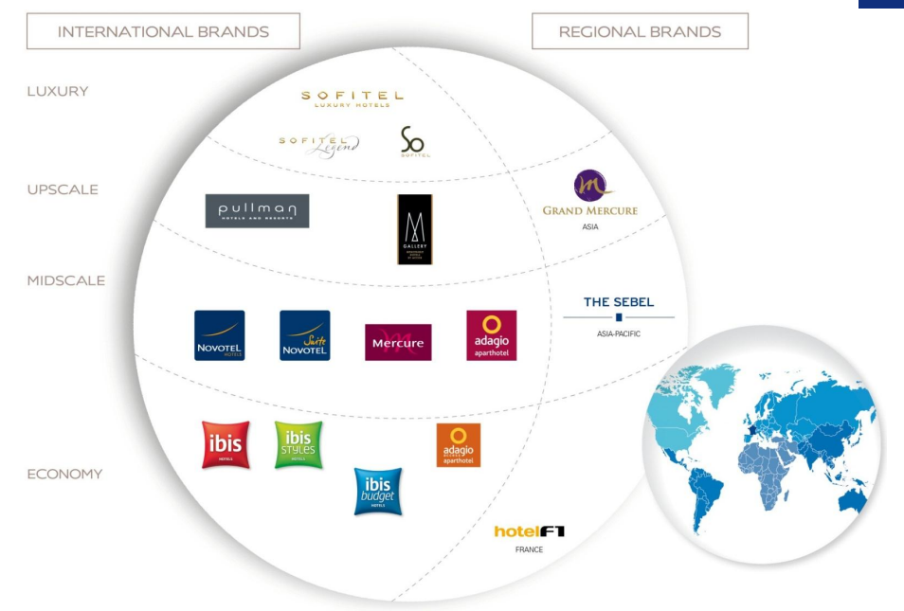
Accor (before 2015)
In 2010, Accor moved towards an ‘asset-light” strategy. The company was organized into two businesses:
Hotel Invest : Real Estate Investment Business; Owning and leasing hotel assets.
Hotel Service : Operating Business; Running hotel operations for both Accor and other-owned properties.
By 2014, Accor managed 14 global brands spread across 6 continents, that lent their names to 3,717 hotels with 482,000 rooms.
Accor expanded aggressively and opened 208 new hotels with 30,000 rooms in 2014 with 156,000 more in the pipeline.

Slide 4
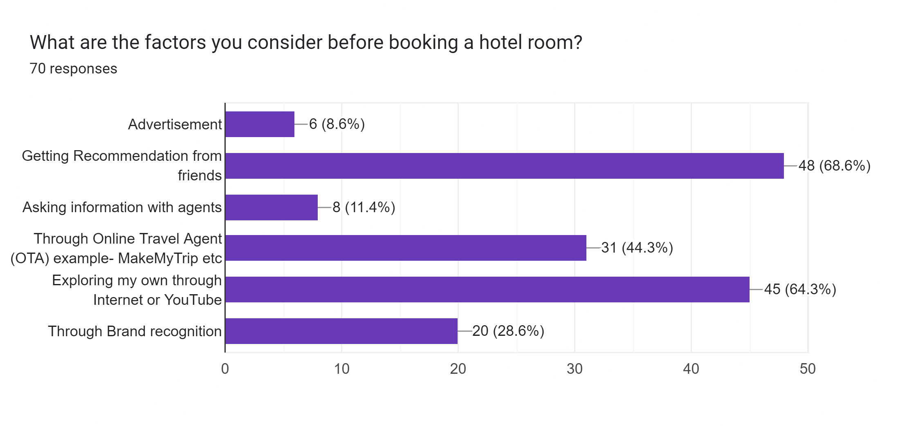
Survey Stats

Slide 5
Accor’s Take on the changing industry
Hospitality Industry was turning into a Digital Warzone for every room night.
In 2014, 35% of Accor’s sales were generated online.
Accor’s Target:
Use OTAs for Customer Acquisition
Thereon, keep Customers within the Accor Ecosystem
More Direct Bookings : Saved Commission Fees
Benefits of Direct Bookings to Customer:
Trustworthy Portal
Loyalty Benefits (La Club Accorhotels)
“OTAs are a great innovation, but if you are big enough, and Accor is, you have to control your destinations.” – Sebastian Bazin

Slide 6
Accor’s Digital hospitality program
Accor invested a sum of €225 million for a five-year “Digital Hospitality” initiative, which was used to develop and improve branded websites and mobile apps.
In 2014, Accor made €2.1 billion from online bookings directly through Accor’s websites, compared to €1.05 billion from OTAs.
Strong digital footprint. 200 million unique visitors to Accor owned websites.
Approximate Number of Bookings on the Website:
= 28.72 million = 13.6775% of Total Visits
Which is significantly higher than 5%, what RoomKey’s founders got on their sites.
$$\frac{Revenue from online bookings}{Average Daily Rate}= \frac{\$2.793 billions (converting € to \$ using 2014 average conversion rate)}{\$97.24 (Exhibit 8 Case Study)}$$

Slide 7
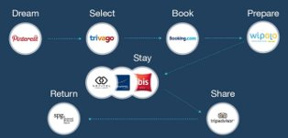
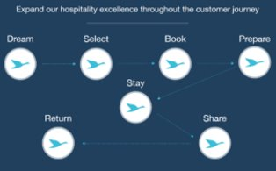
Accor’s Target from the initiative
Provide Greater Simplicity, Fluidity, and Recognition at every stage of the Customer Experience.
New Initiatives –
Mobile First: Acquired French start-up Wipolo
Mobile App accounted for 12% of current web sales
Acted as a companion – before, during and after the stay
Customer Centric: Strengthening CRM process
Voice of the Guests: Centralized Guest Database
SMART: in-house recommendation engine
Seamless Journey: Welcome by le Club Accorhotels
Electronic Payment Solutions
One-Click Booking
Online check-in and check-out
[Exhibits 3 & 4]

Slide 8
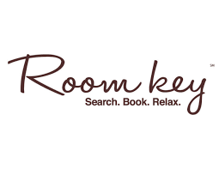


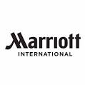

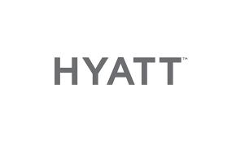
Room Key
A Hotel Meta-Search website founded by the consortium of six major hotel brands in 2012.
RoomKey was designed to recover shoppers who abandoned their search on a partners’ individual website.
It appeared as a pop-under ad when a visitor exits the hotel website of a RoomKey Partner.
Thereafter, RoomKey curated only properties owned by the founders and partners, keeping shoppers in a limited ecosystem.
Users were then redirected to the partners’ website they choose, to let them book directly.
RoomKey
Partners
Individual Partner
Keeping Visitors in a Closed Loop

Slide 9
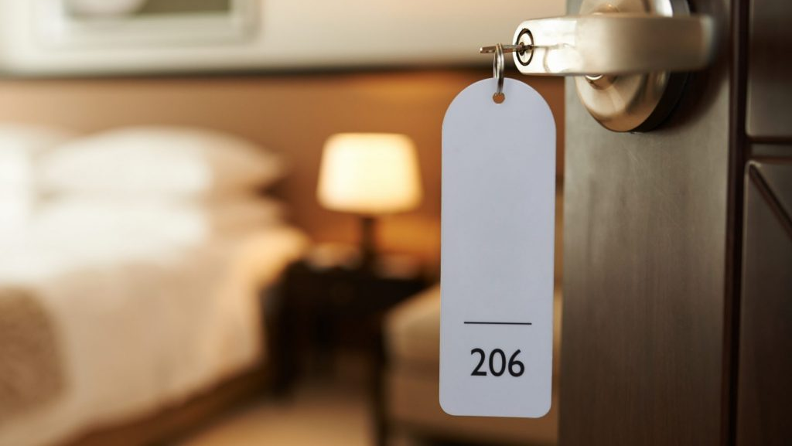
Two Options to be a Partner:
About €10 million upfront; 10% commission per booking
€0 upfront; 15% commission per booking
Less commission fees than OTAs (typically 25%)
Increased Traffic to Partners’ websites
Benefits to Consumers
Loyalty Program Benefits due to direct booking​
Avoid hidden charges/penalties​
Could receive customized service (e.g., requesting specific rooms)​
Benefit to Partners

Slide 10
S.W.O.T. Analysis for Accor
Strengths
Weaknesses
S
W
Heritage and Experience
Unique and Wide Portfolio
Strong Customer Relationship
Opportunities
O
T
Threats
Increasing Online Booking Penetration
Increasing OTA vs Direct Penetration
Alternative Hospitality Concepts

Slide 11
Room key s-t-p Analysis
Segmentation
User Status
Readiness Stage
Targeting
Customers lost on Partners’ Websites
Positioning
Trustworthy portal to book hotels

Slide 12
Question 1: Should Accor Associate with Room Key?

Slide 13
NO

Slide 14
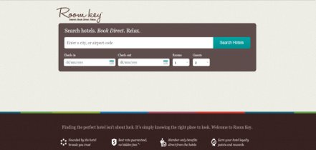
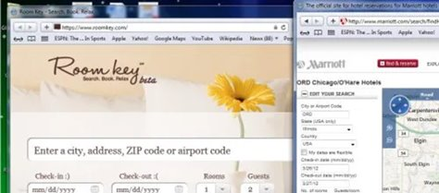
Visible problems with Room Key
RoomKey functioned like a meta-search site and lacked the functionality of traditional OTAs. Couldn’t offer packages like Travel + Stay.
RoomKey's subpar interface and non-intuitive UX Design.​​
Pop under ads are intrusive but unnoticeable at the same time.
42% users used ad-block technology, 44% users find ads intrusive, and 38% users fear viruses or bugs from ads according to Forbes.​
RoomKeyinterfacefromWebArchiveshttps://web.archive.org/web/20210920222808/http://roomkey.com/​

Slide 15
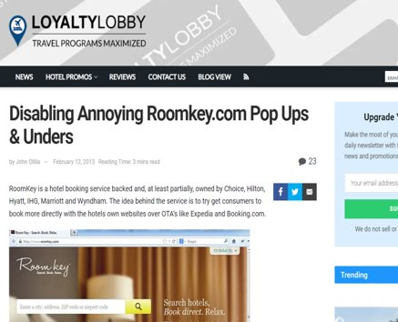
POP-under ads were found irritating, and many ways were devised to block them
https://loyaltylobby.com/2013/02/12/disabling-annoying-roomkey-com-pop-ups-unders/

Slide 16
Room key’s shaky value proposition
Double edged relationship with OTAs. Despite added room network, members were losing traffic to OTAs up to 24% thus opening the 'closed-loop’.
Hoteliers were renegotiating with OTAs to rein in outlandish commission rates taking away from RoomKey's selling point​.
Selective Loyalty points initiative was unsustainable as customers still had to enroll individually to loyalty programs of each member.
An overall lack of awareness among customers and a half-hearted efforts of members in a highly competitive domain was not sustainable​.

Slide 17

Reaching the decision
Accor's decision to join RoomKey revolved around whether RoomKey aligned with Accor's own digital strategy and whether RoomKey was succeeding in providing value to its Member Brands.​
Joining Room Key would’ve negatively affected Accor’s Brand Equity.

Slide 18


“All of us. For the last 15 years, we’ve been sleeping. I said that publicly and I got yelled at by my peers. Let’s face it, we’ve missed three waves in the digital revolution. The first wave 12 years ago, the OTAs. Did we move? No, of course not."
"I guess we’ve done two things. One, we’ve bought a company called Wipolo, which is an aggregator of tickets from rail, cars, museums, hotels, you name it, you have your own mobile application. Then we bought Fastbooking, which was 120 people, and is basically a digital channel service provider for the outside independent owners."
Sebastian Bazin, CEO of Accor Group
“Hotels would be much better off, right now, pulling the plug on Room Key,”
“Shutting it down, before they waste another penny on it. If I were a shareholder at a hotel company, I’d be furious that these brands diverted precious financial resources from the brands to this ill-fated exercise.”
Henry Harteveldt, top travel industry analyst
Interview with skift.com in November 2015 - https://skift.com/2015/11/19/interview-accor-hotels-ceo-on-moving-fast-while-others-fail/

Slide 19
Question 2: What could room key have done to Succeed?

Slide 20
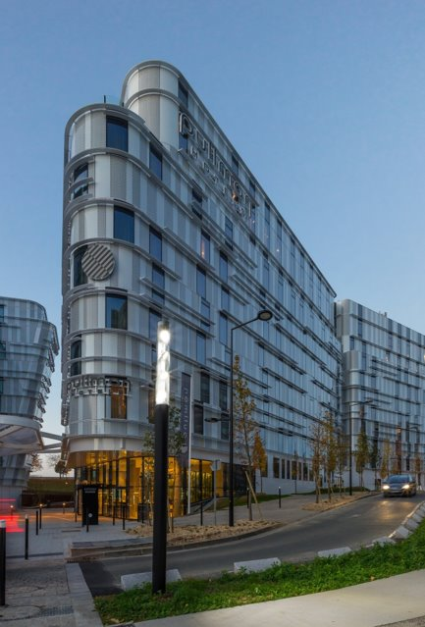
Fund RoomKey's Marketing – OTAs had a much bigger marketing budget than that of hotel chains. While Founders, Hilton launched "Stop clicking around" and Marriott launched "It pays to book direct", they never promoted RoomKey through their platforms. Brands were out for themselves. ​
Get partners to cooperate with each other and fully commit to RoomKey.
Invest in providing a better digital experience to the customers and improve functionality of RoomKey.​
Introduce a RoomKey loyalty program that rewards points for any member the customers choose to book with, Bonuses for recommending the platform to other users and introduce premium membership programs similar to OTAs. This would help build Customer Loyalty and Retention.​

Slide 21
Better option?
Equity Partner | Commercial Partner
10 M € Infront investment + 10% commission for each booking | 0 € Infront Investment + 15% commission for each booking
Accor’s Net Gross Revenue – 11.90 B €
Accor’s Online Sale – 4.17 B € (35% of total sale)
Accor’s sale through OTAs - 1.67 B € (14% of total sale)
For short term association : Commercial Partner is best choice
For Long term association : Equity Partner is best choice
Number of Years for break even | Revenue in M € | % share of Net Revenue
N=1 | X=200 | 1.68%
N=2 | X=100 | 0.84%
N=3 | X=66 | 0.05%
N=4 | X=50 | 0.04%

Slide 22
Current scenario

Slide 23

Room key
In June 2020, Room Key announced that it would be shutting down all hotel search functionality and would be deleting all consumer data. ​
The message read, in part: "At RoomKey, our goal has always been honesty. The truth is that RoomKey is in the process of redefining our business operations. Starting June 8, Roomkey.com will no longer provide hotel search services." ​

Slide 24

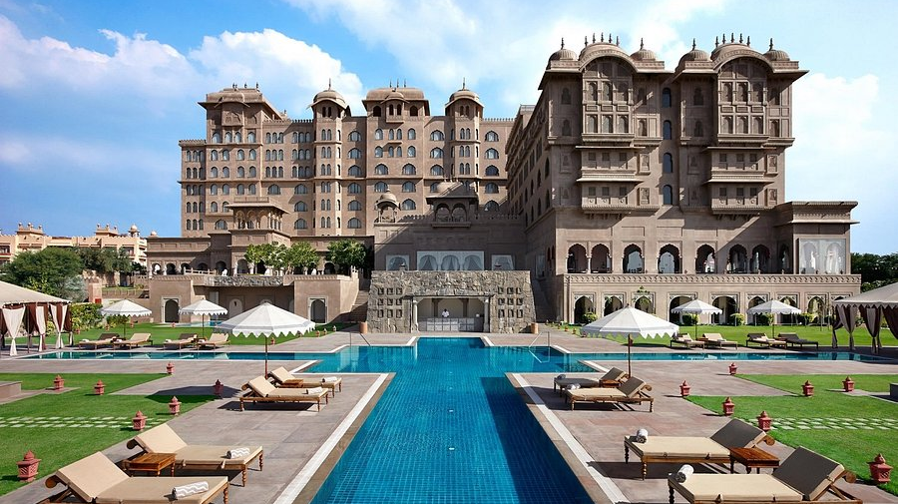
Accor
Accor now has a portfolio of 41 Hotel Brands, spread across 116 countries, with 5,341 hotels having a total of 783,587 rooms.
Accor has 8 brands in Luxury Segment, which include Fairmont, Raffles, Sofitel.
Accor has 10 brands in Premium Segment (Pullman, e.g.), and 4 brands in Midscale Segment (Adagio, Novotel e.g.)
In Economy Segment, Accor has 6 brands, with the most renowned one being Ibis which is further extended to Ibis Budget and Ibis Styles.
Apart from these, Accor has a Lifestyle Collective Segment which has 14 Brands, and is primarily focused on providing unique and extravagant experiences.
Accor has a renamed Loyalty Program called Accor Live Limitless.
It offers Room Upgrades, Discounts, Free Rooms based on the tier and number of points the customer has.

Slide 25
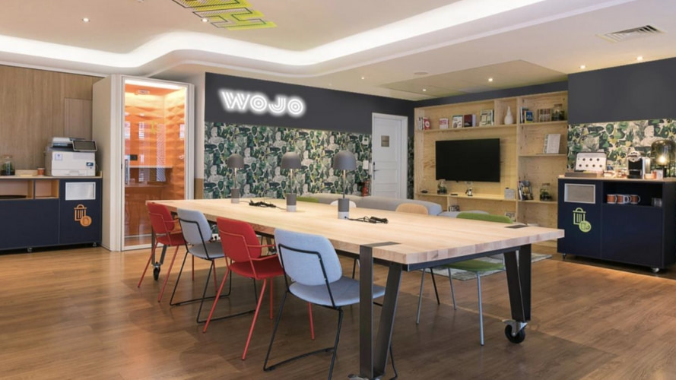
More brands and services by Accor
Co-working and Entertainment:
Accor offers services like Fine Dining and Clubs through brands like Paris Society, Potel et Chabot, and Thalassa Sea and Spa.
Accor also offers flexible offices and workspaces through its brand Wojo.
Business Accelerators:
Accor’s Astore provides Procurement Assistance services for food and furniture to equipment and household products to professional services.
D-EDGE offers leading-edge cloud-based e-commerce solutions to more than 17,000 hotels in over 100 countries.
John Paul provides companies and brands with relationship marketing strategies for their clients and collaborators.
ResDiary is a flat-fee online table reservation system offered by Accor.

Slide 26
OOPs! It seems we Ran out of slides, so we guess this is
The
END

